Slide 1







Next Gen Employability Program
NEXT GEN EMPLOYABILITY PROGRAM Creating a future-ready workforce
Team Members:
College Name
Student Name : SRIRAMPRASAND R S Student ID : au814721104053
SRM TRP Engineering College

Slide 2

Next Gen Employability Program
CAPSTONE PROJECT SHOWCASE
Project Title
Notes Sharing Web Application using Django Framework
Abstract | Problem Statement | Project Overview | Proposed Solution | Technology Used | Modelling & Results | Conclusion

Slide 3
Next Gen Employability Program
Abstract
Our forthcoming web platform seeks to simplify document exchange among educators and students within an academic environment. Developed utilizing the Django framework, it will offer an intuitive interface for uploading, downloading, and organizing files. Users can register accounts, participate in designated groups (such as classes or departments), and distribute files within these groups. Emphasis will be placed on maintaining robust security measures to safeguard files, permitting access solely to authorized individuals. Ultimately, the objective is to optimize the sharing of documents and foster collaboration within educational circles.”
Source :

Slide 4
Next Gen Employability Program
Problem Statement
In conventional academic settings, the exchange of documents between students and instructors can be ineffective and burdensome. Students frequently need to submit assignments or access learning materials, while instructors must disseminate course materials and provide feedback. However, current approaches, such as email or physical submissions, lack structure and can result in disarray or misplaced documents.
To tackle these obstacles, our initiative aims to create a web-based tool that facilitates smooth document sharing between students and instructors. This platform will serve as a centralized hub for uploading, downloading, and organizing files, fostering collaboration and productivity within educational circles." ¹
Source :

Slide 5
Next Gen Employability Program
Project Overview
Our forthcoming web platform seeks to simplify document exchange among educators and students within an academic environment. Developed utilizing the Django framework, it will offer an intuitive interface for uploading, downloading, and organizing files. Let’s delve into the key features:
User Authentication: Students and instructors can create accounts, sign in, and manage their profiles.
Rigorous user verification ensures that only authorized individuals gain access.
File Organization: Users can upload files, categorize them into directories, and retrieve shared files.
The application will seamlessly handle diverse file types, including documents, images, and videos.
Group Supervision: Users can establish or join groups (such as classes or departments) and distribute
files within these groups.
Access Management: Files will be accessible solely to sanctioned group members,
ensuring confidentiality and privacy. Administrators can configure permissions for viewing, uploading, or
deleting files within a group.
Notifications: Users will receive alerts for new file uploads, comments, or relevant activities within their
groups, enhancing engagement with the platform.
Search Feature: Users can search for files based on keywords, tags, or other criteria, streamlining the
process of locating relevant materials.
In essence, our proposed solution addresses the shortcomings of traditional file-sharing methods in
educational settings, providing a resilient platform for secure and efficient file exchange among students and
teachers."
Source :

Slide 6
Next Gen Employability Program
Proposed Solution
.
Our forthcoming web platform seeks to simplify document exchange among educators and students within an academic environment. Developed utilizing the Django framework, it will offer an intuitive interface for uploading, downloading, and organizing files. Let’s delve into the key features:
User Administration: Both students and instructors can create accounts, sign in, and manage their profiles.
Rigorous user verification ensures that only authorized individuals gain access.
File Organization: Users can upload files, categorize them into directories, and retrieve shared files. The
application will seamlessly handle diverse file types, including documents, images, and videos.
Group Supervision: Users can establish or join groups (such as classes or departments) and distribute files within
these groups.
Access Management: Files will be accessible solely to sanctioned group members, ensuring confidentiality and
privacy. Administrators can configure permissions for viewing, uploading, or deleting files within a group.
Notifications: Users will receive alerts for new file uploads, comments, or relevant activities within their groups,
enhancing engagement with the platform.
Search Feature: Users can search for files based on keywords, tags, or other criteria, streamlining the process of
locating relevant materials.
Adaptive Layout: The application will feature an adaptive design, ensuring accessibility and usability across various
devices, including computers, laptops, tablets, and smartphones.
In summary, our proposed solution aims to provide an intuitive and effective platform for students and instructors,
fostering collaboration and communication within educational communities.

Slide 7
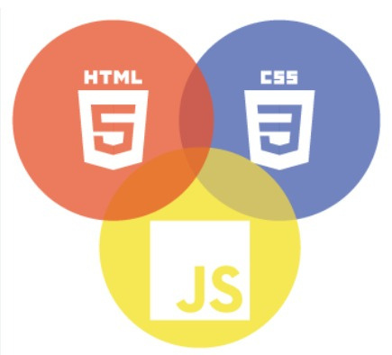

Next Gen Employability Program
Technology Used
Front-end
Back-end
Source :

Slide 8
Next Gen Employability Program
Modelling & Results
Our developed web platform caters to both students and teachers. Upon visiting the landing page, users encounter login and signup options, serving as the entry point to the application. Rigorous validation processes, including those for ‘username’ and ‘password’, ensure robust security.
Once logged in, students seamlessly navigate to a home page where they can view and download files shared by teachers. Conversely, teachers, upon login, gain the ability to upload files. In the event of a username or password mismatch, the webpage promptly indicates restricted access. Additionally, any errors trigger a 404 page, signaling ‘page not found’.
Our goal is to create a user-friendly environment that fosters efficient document exchange within the academic community
Source :

Slide 9
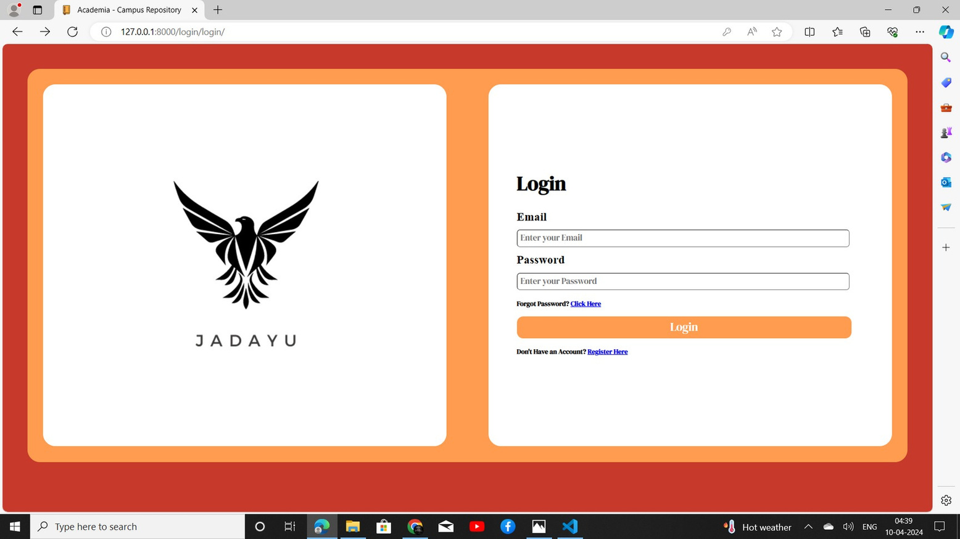
Next Gen Employability Program
Login page

Slide 10
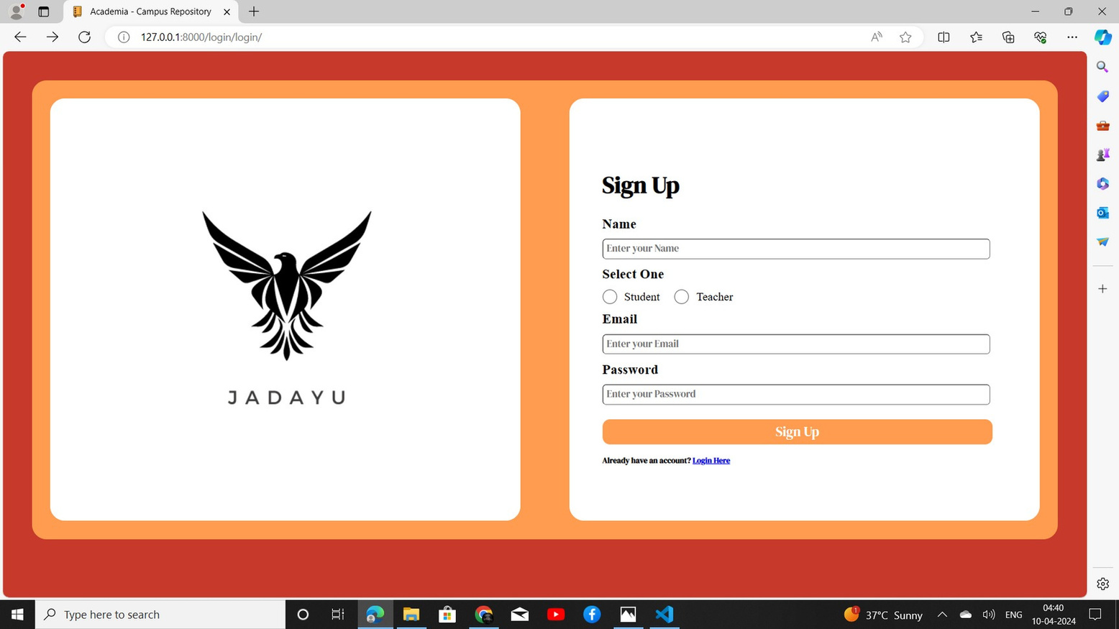
Next Gen Employability Program
Sign up page

Slide 11
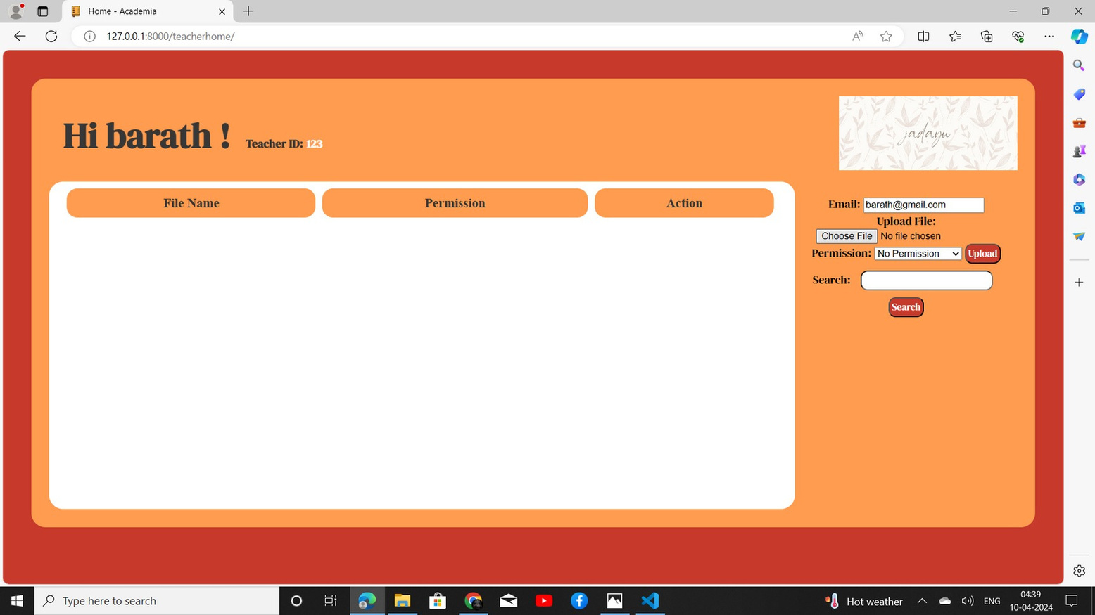
Next Gen Employability Program
Teachers home page

Slide 12
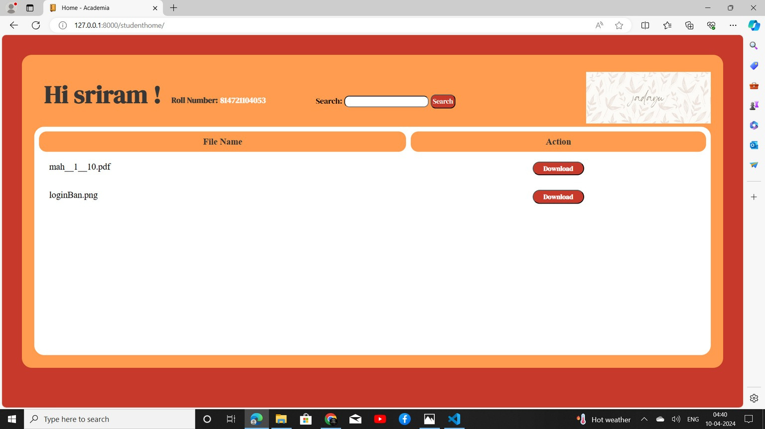
Next Gen Employability Program
Students home page

Slide 13
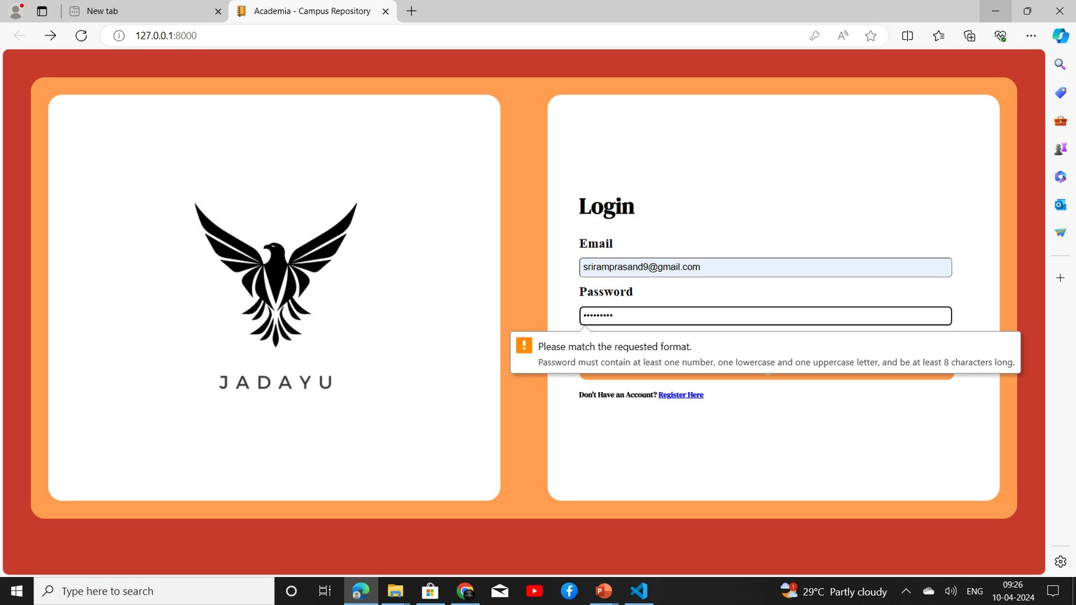
Next Gen Employability Program
Error notification page

Slide 14
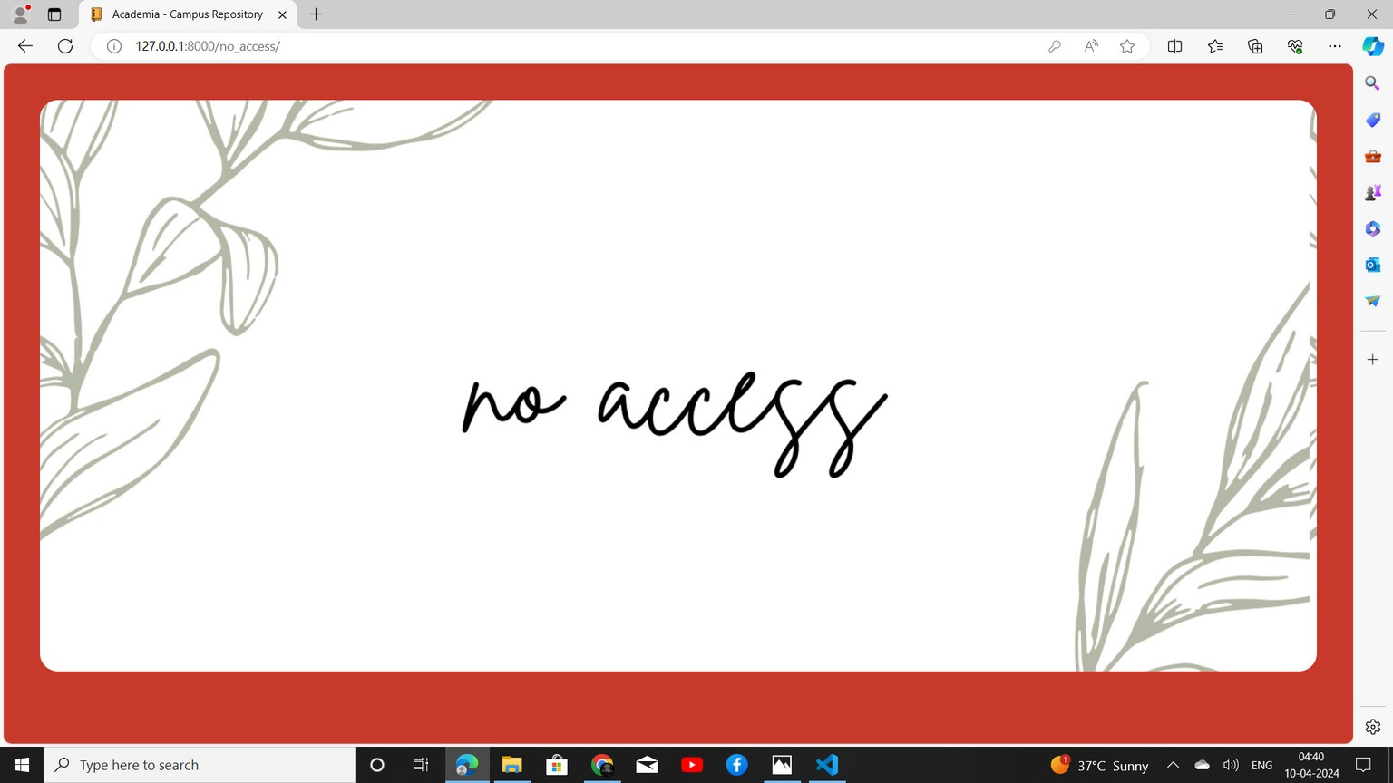
Next Gen Employability Program
No access

Slide 15
Next Gen Employability Program
Future Enhancements:
Our forthcoming web platform aims to streamline document exchange among educators and students within an academic environment. We plan to integrate the application with Learning Management Systems (LMS)—renowned platforms used in educational workflows. This integration will enhance efficiency and seamlessly connect our platform with existing academic processes.
Let’s delve into the key enhancements:
File Versioning: We’ll incorporate version control for files, allowing users to track changes and revert to previous
versions when needed.
Cloud Storage Integration: Users can connect their cloud storage accounts (such as Google Drive or Dropbox)
for seamless file access and sharing.
Real-time Collaboration: We’ll introduce features for live collaboration on documents, enabling simultaneous
editing and commenting.
Advanced Search: Elevate the search capability by adding filters, sorting features, and the ability to search within
file contents.
Analytics and Reporting: Our platform will offer analytics and reporting functionalities to monitor file usage, user
interactions, and engagement metrics.
Integration with Online Learning Tools: By merging with online learning tools (such as quizzes or forums), we’ll
provide a comprehensive educational platform.
These improvements will enrich the functionality and user-friendliness of our file-sharing application, making it an
even more valuable resource for students and educators within educational settings.

Slide 16
Next Gen Employability Program
Conclusion
Our forthcoming web platform aims to simplify document exchange among educators and students within an academic environment. Developed utilizing the Django framework, it will offer an intuitive interface for uploading, downloading, and organizing files. Let’s delve into the key features:
User Administration: Both students and instructors can create accounts, sign in, and manage their profiles. Rigorous user verification ensures that only authorized individuals gain access.
File Organization: Users can upload files, categorize them into directories, and retrieve shared files. The application will seamlessly handle diverse file types, including documents, images, and videos.
Group Supervision: Users can establish or join groups (such as classes or departments) and distribute files within these groups.
Access Management: Files will be accessible solely to sanctioned group members, ensuring confidentiality and privacy. Administrators can configure permissions for viewing, uploading, or deleting files within a group. Notifications: Users will receive alerts for new file uploads, comments, or relevant activities within their groups, enhancing engagement with the platform
In essence, our proposed solution addresses the shortcomings of traditional file-sharing methods in educational settings, providing a resilient platform for secure and efficient file exchange among students and teachers."
Source :

Slide 17
Next Gen Employability Program
Thank You!

